Slide 1
Planting date strategies and risk: Towards greater economic benefits in rice-wheat systems in Bihar
Maxwell Mkondiwa
Anton Urfels
Others

Slide 2
Motivation
Indo-Gangetic Plains—the food basket of the world through a rice-wheat cropping system has over the recent past experienced two major climatic changes
Late monsoon onset which pushes farmers to transplant rice late
Terminal heat stress which reduces wheat yield
Early sowing of wheat would allow the wheat crop to escape terminal heat stress
Late sowing of wheat is however highly associated with delays in the harvesting of rice crop
Advancing rice sowing date so as to prepare early for wheat sowing has been considered the entry point for rice-wheat system optimization

Slide 3
Related literature
Stability analyses of agricultural technology benefits
Urfels et al (2022), Montes et al (2022)
Chimonyo et al (2019)
Spatial risk assessment of technology benefits
Heterogeneity in returns to technology adoption and risk preferences have been proposed to affect lack of adoption of profitable innovations
See Hurley et al 2018, Suri 2011, Dercon
Mean-variance analysis (Sukcharoen and Leatham 2016)
Second order stochastic dominance and risk aversion: Hurley et al (2018)
We rely on second order stochastic dominance because it directly relates to risk aversion and does not rely on only two moments of the data as the mean-variance analysis

Slide 4
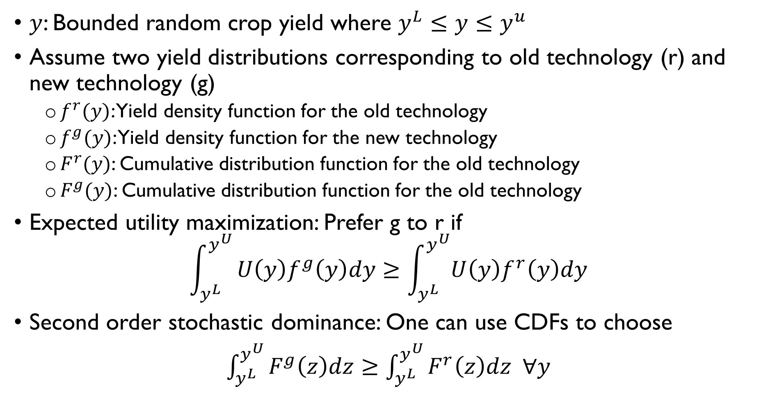
Model: Notation and definitions
$y$: Bounded random crop yield where $y^{L}≤y≤y^{u}$
Assume two yield distributions corresponding to old technology (r) and new technology (g)
$f^{r}(y)$: Yield density function for the old technology
$f^{g}(y)$: Yield density function for the new technology
$F^{r}(y)$: Cumulative distribution function for the old technology
$F^{g}(y)$: Cumulative distribution function for the old technology
Expected utility maximization: Prefer g to r if
$$\int_{y^{L}}^{y^{U}}{U\left(y\right)f^{g}\left(y\right)dy≥\int_{y^{L}}^{y^{U}}{U\left(y\right)f^{r}\left(y\right)dy}}$$
Second order stochastic dominance: One can use CDFs to choose
$\int_{y^{L}}^{y^{U}}{F^{g}\left(z\right)dz≥\int_{y^{L}}^{y^{U}}{F^{r}\left(z\right)dz ∀y}}$

Slide 5
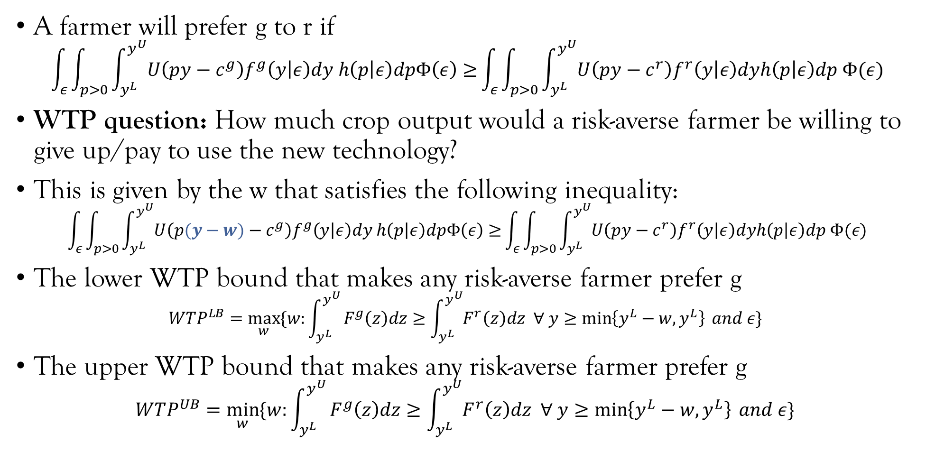
Computational Risk Optimization Model
A farmer will prefer g to r if
$$\int_{ε}{\int_{p>0}{\int_{y^{L}}^{y^{U}}{U\left(py−c^{g}\right)f^{g}\left(y | ε\right)dy h\left(p | ε\right)dpΦ\left(ε\right)≥}\int_{ε}{\int_{p>0}{\int_{y^{L}}^{y^{U}}{U\left(py−c^{r}\right)f^{r}\left(y | ε\right)dyh\left(p | ε\right)dp Φ(ε)}}}}}$$
WTP question: How much crop output would a risk-averse farmer be willing to give up/pay to use the new technology?
This is given by the w that satisfies the following inequality:
$$\int_{ε}{\int_{p>0}{\int_{y^{L}}^{y^{U}}{U\left(p(y−w)−c^{g}\right)f^{g}\left(y | ε\right)dy h\left(p | ε\right)dpΦ\left(ε\right)≥}\int_{ε}{\int_{p>0}{\int_{y^{L}}^{y^{U}}{U\left(py−c^{r}\right)f^{r}\left(y | ε\right)dyh\left(p | ε\right)dp Φ(ε)}}}}}$$
The lower WTP bound that makes any risk-averse farmer prefer g
$$WTP^{LB}=\max_{w}{\{w:\int_{y^{L}}^{y^{U}}{F^{g}\left(z\right)dz≥\int_{y^{L}}^{y^{U}}{F^{r}\left(z\right)dz ∀ y≥\min\left\{y^{L}−w,y^{L}\right\}} and ε\} }}$$
The upper WTP bound that makes any risk-averse farmer prefer g
$$WTP^{UB}=\min_{w}{\{w:\int_{y^{L}}^{y^{U}}{F^{g}\left(z\right)dz≥\int_{y^{L}}^{y^{U}}{F^{r}\left(z\right)dz ∀ y≥\min\left\{y^{L}−w,y^{L}\right\}} and ε\} }}$$

Slide 6
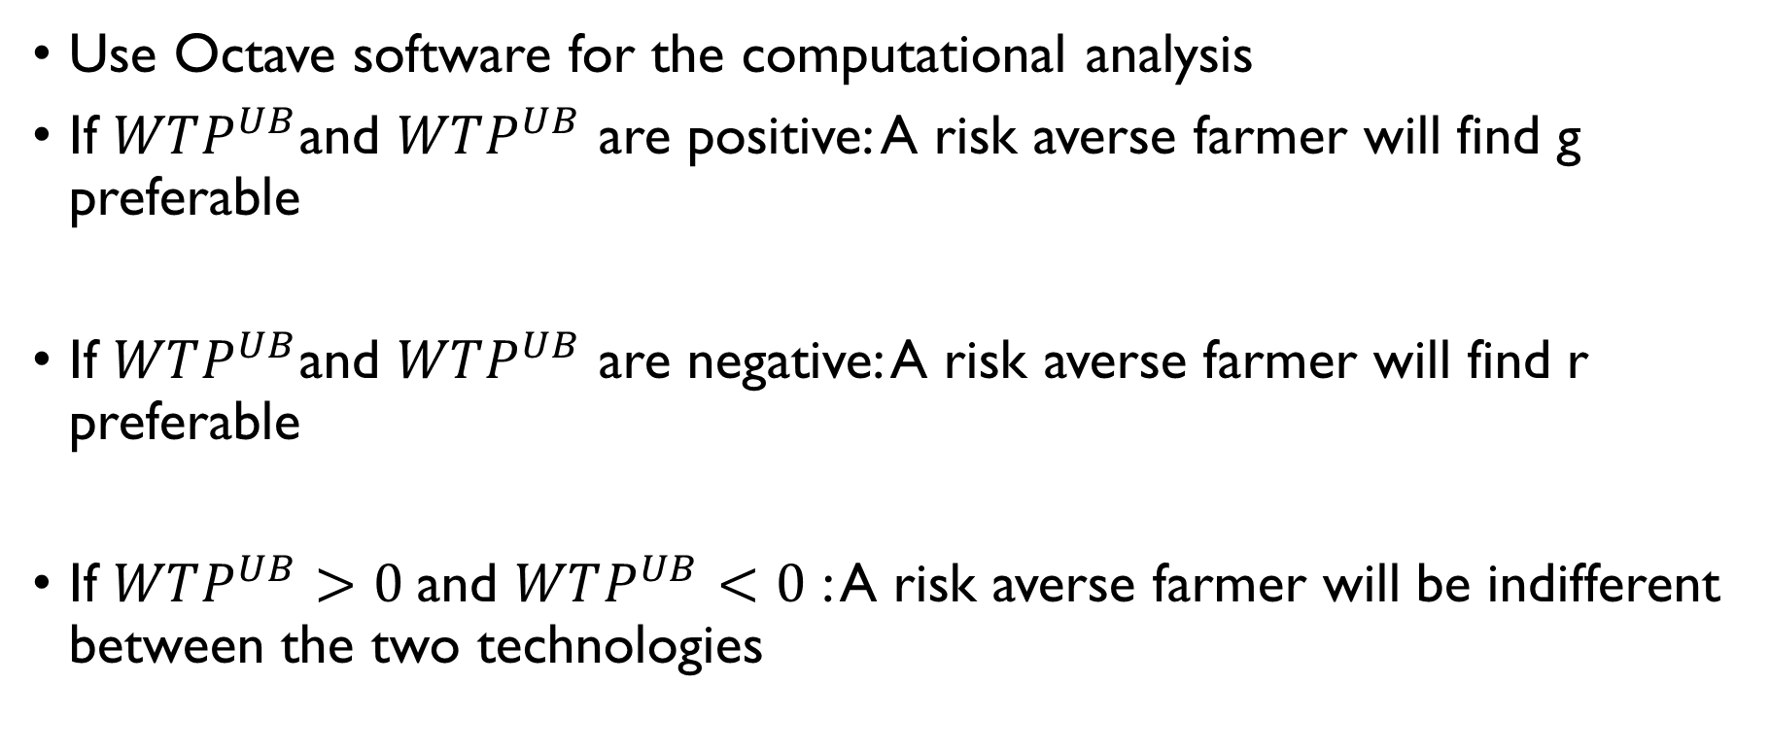
Decision heuristics
Use Octave software for the computational analysis
If $WTP^{UB}$and $WTP^{UB}$ are positive: A risk averse farmer will find g preferable
If $WTP^{UB}$and $WTP^{UB}$ are negative: A risk averse farmer will find r preferable
If $WTP^{UB}>0$and $WTP^{UB}<0$ : A risk averse farmer will be indifferent between the two technologies

Slide 7
Data and crop simulation models
Scenario number | Rice | Wheat | Description
S0 | Farmer practice | Farmer practice | Farmers’ practice baseline without nutrient and water limitations to understand current limits
S1 | Fixed long (baseline) | Fixed long (baseline) | Planting long duration variety at a fixed recommended date
S2 | Fixed medium | Fixed medium | Planting medium duration variety at a fixed recommended date
S3 | Onset long | Onset long | Planting long duration rice variety at the onset of monsoon
S4 | Onset long supp | Onset long supp | Supplementary irrigation for planting long duration varieties at monsoon onset
S5 | Onset medium | Onset medium
S6 | Onset medium supp | Onset medium supp | Supplementary irrigation for planting medium varieties at monsoon onset

Slide 8
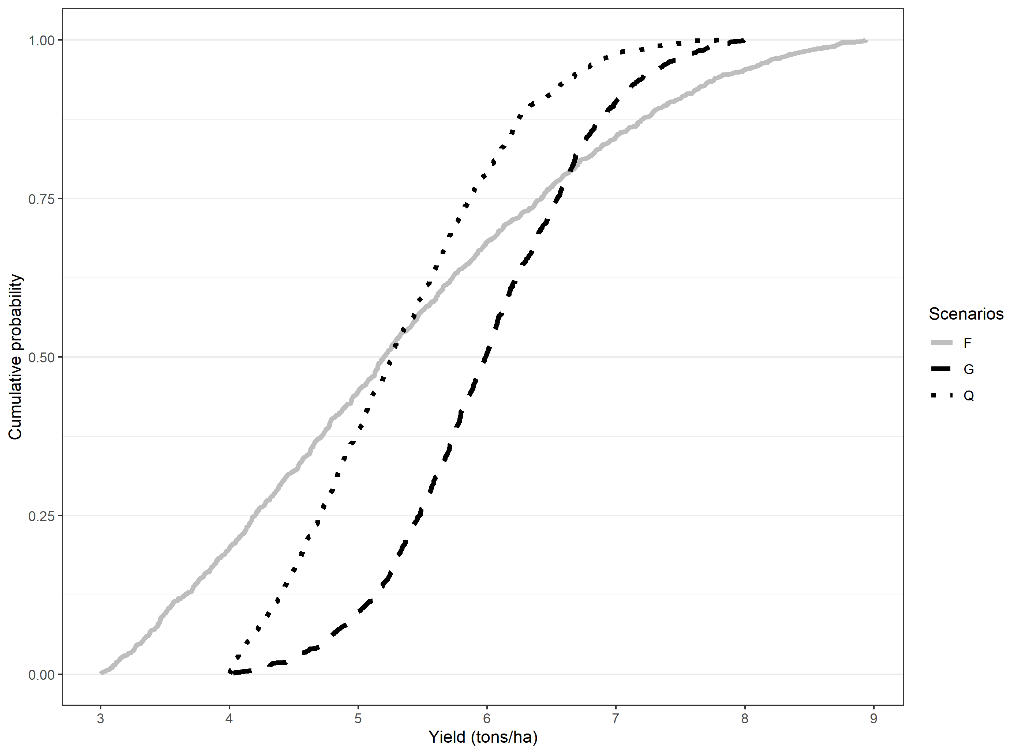
First and second order stochastic dominance
First order stochastic dominance (FOSD)
G FOSD Q
FOSD implies SOSD
Second order stochastic dominance
Assuming same mean, agents prefer the technology with less outcome variance
Based on area of CDFs
G SOSD F
Truncated normal parameters | G | Q | F
N | 1000 | 1000 | 1000
Min=a | 4 | 4 | 3
Max=b | 8 | 8 | 9
Mean | 6 | 5 | 5
SD | 0.8 | 1 | 2

Slide 9
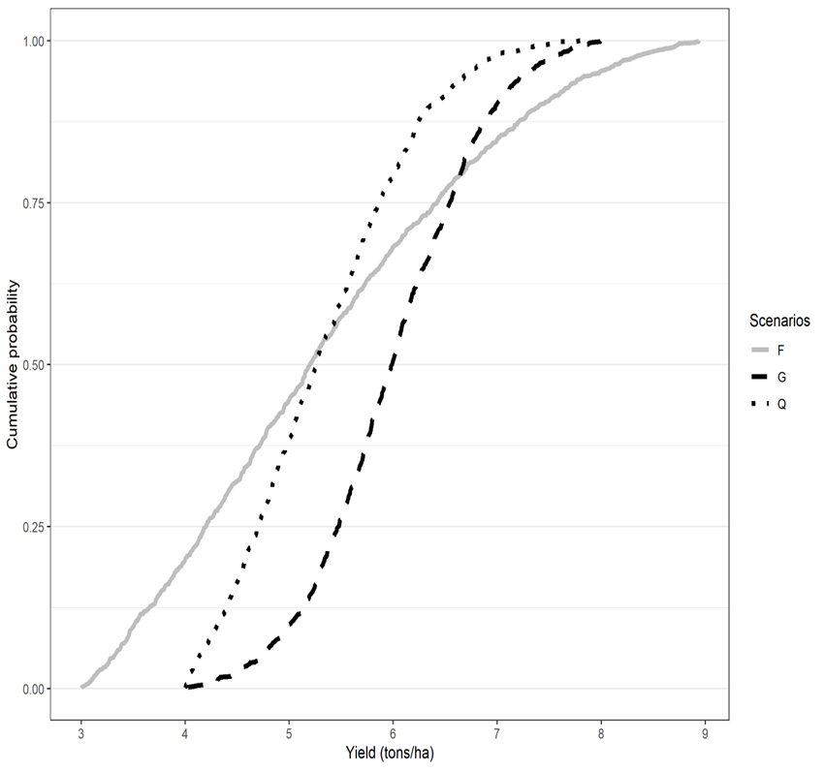
Computational spatial ex-ante economic model under risk aversion
Truncated normal parameters | G | Q | F
N | 1000 | 1000 | 1000
Min=a | 4 | 4 | 3
Max=b | 8 | 8 | 9
Mean | 6 | 5 | 5
SD | 0.8 | 1 | 2
 | Q(base) vs G | Q vs F | F vs G
WTP Lower bound (t/ha) | 0.036 | 0 | 0.499
WTP Upper bound (t/ha) | 0.763 | 0.218 | 1.384
Interpretation | G F/SOSD Q | Not clear | G SOSD Q

Slide 10
RICE

Slide 11
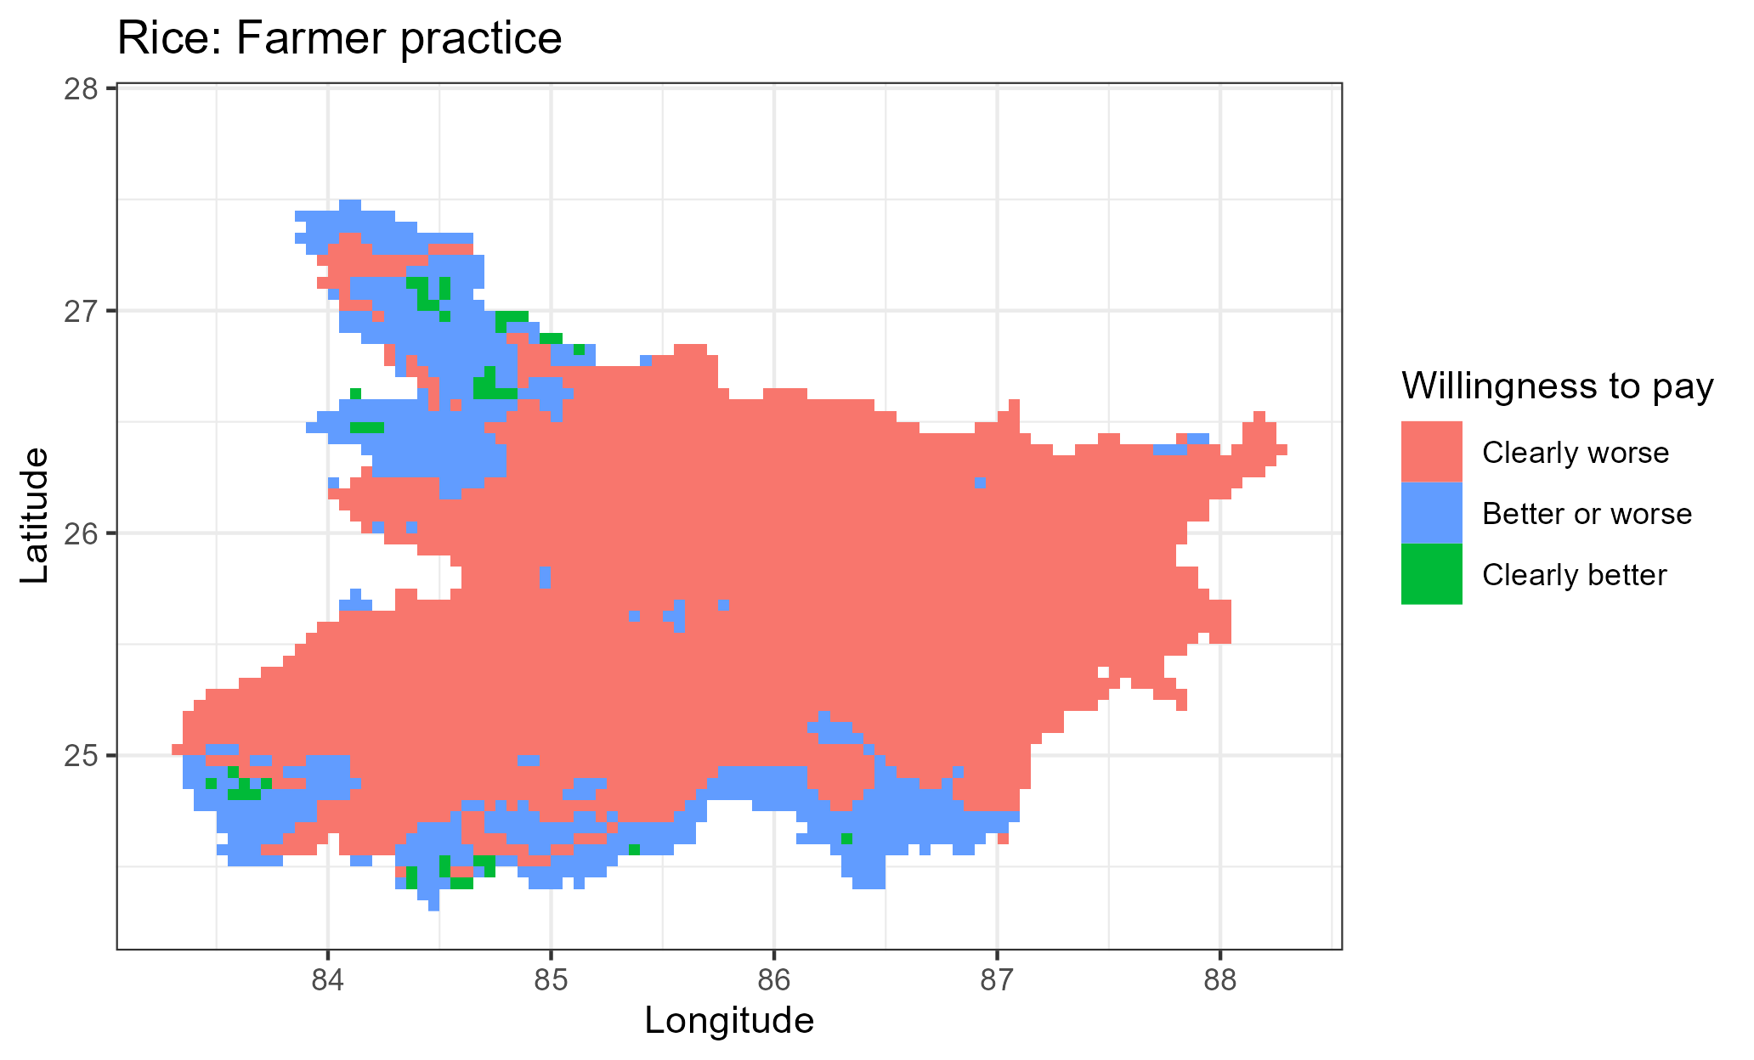
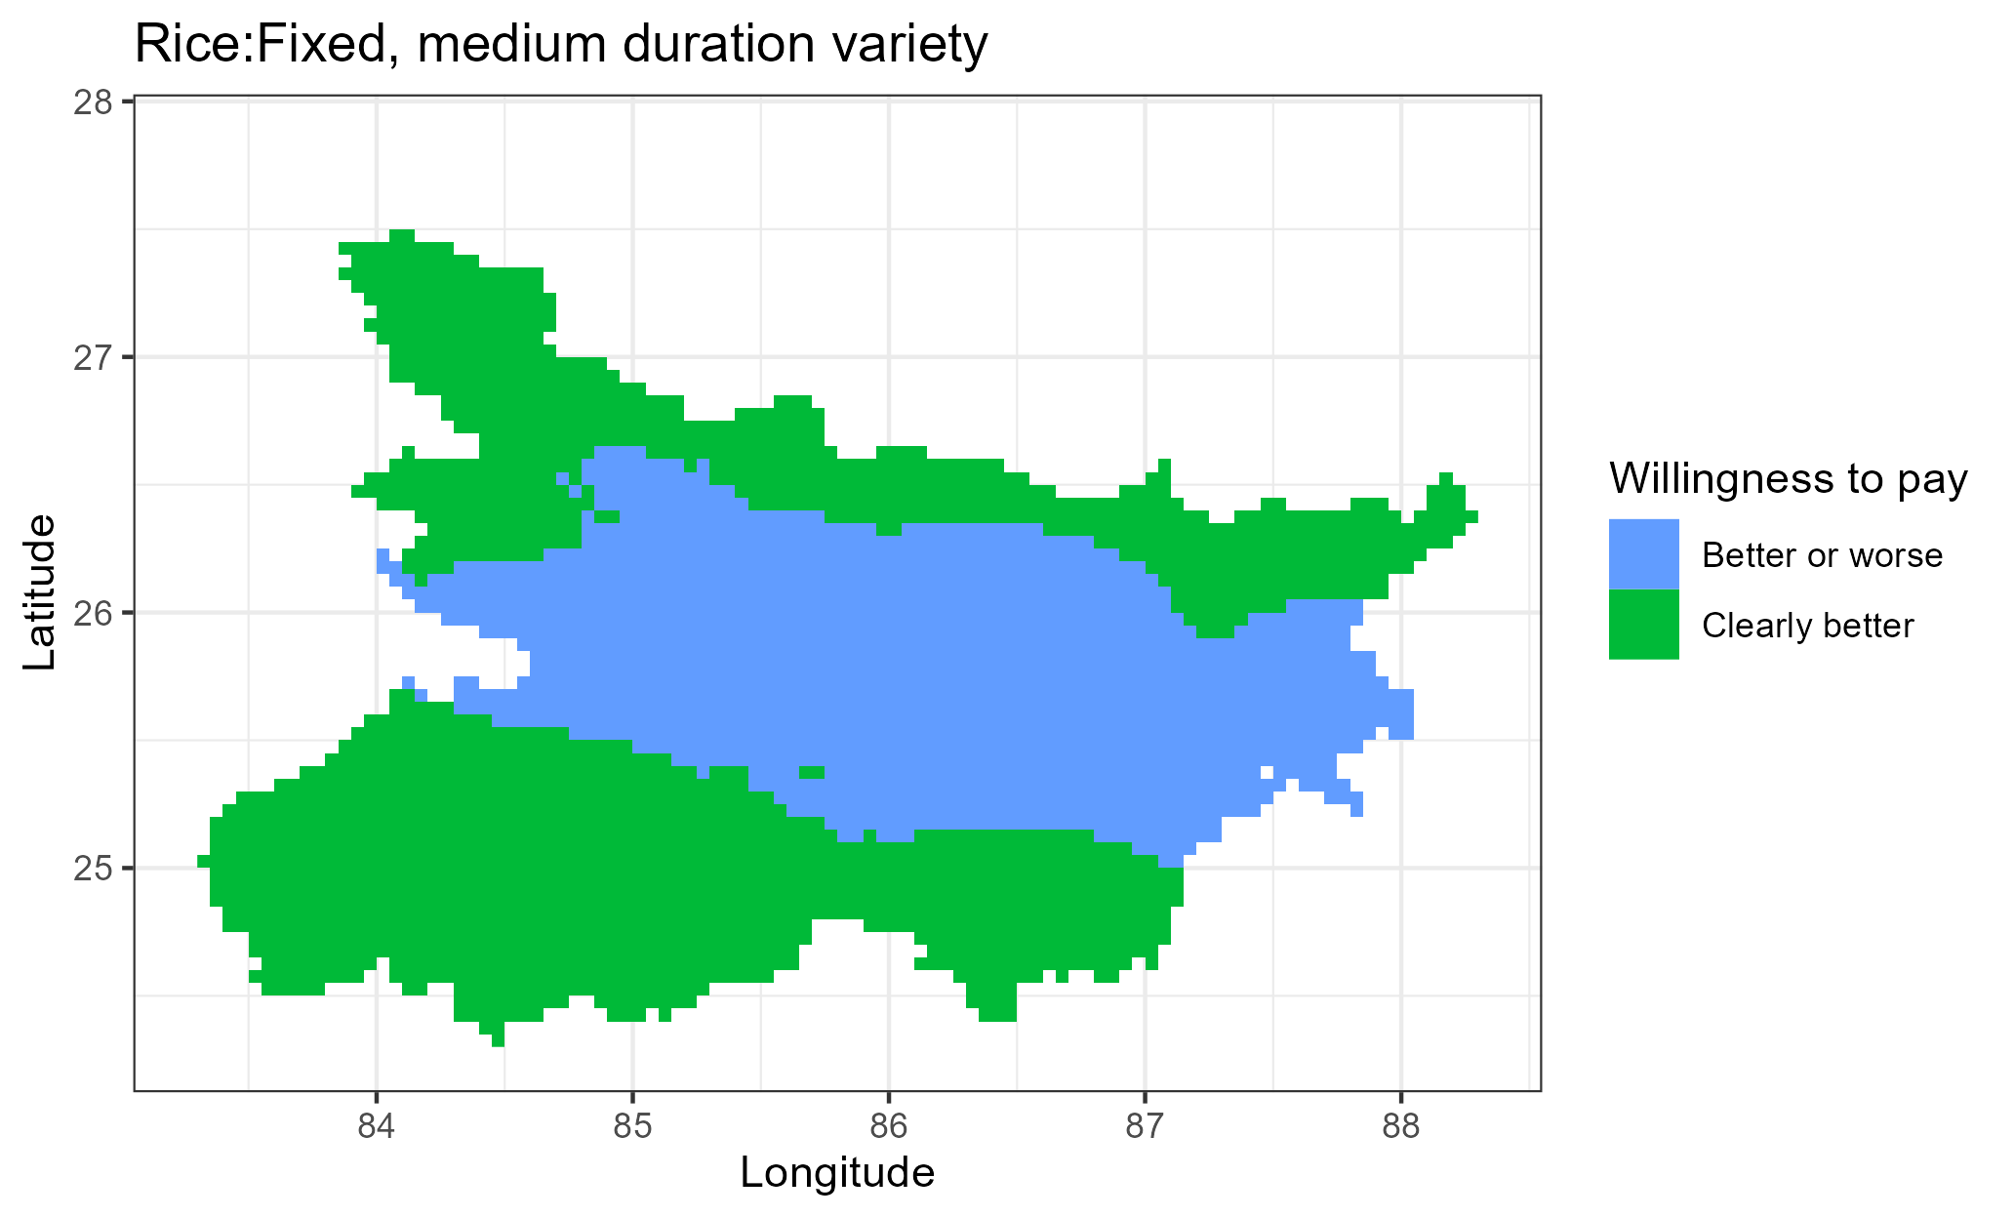
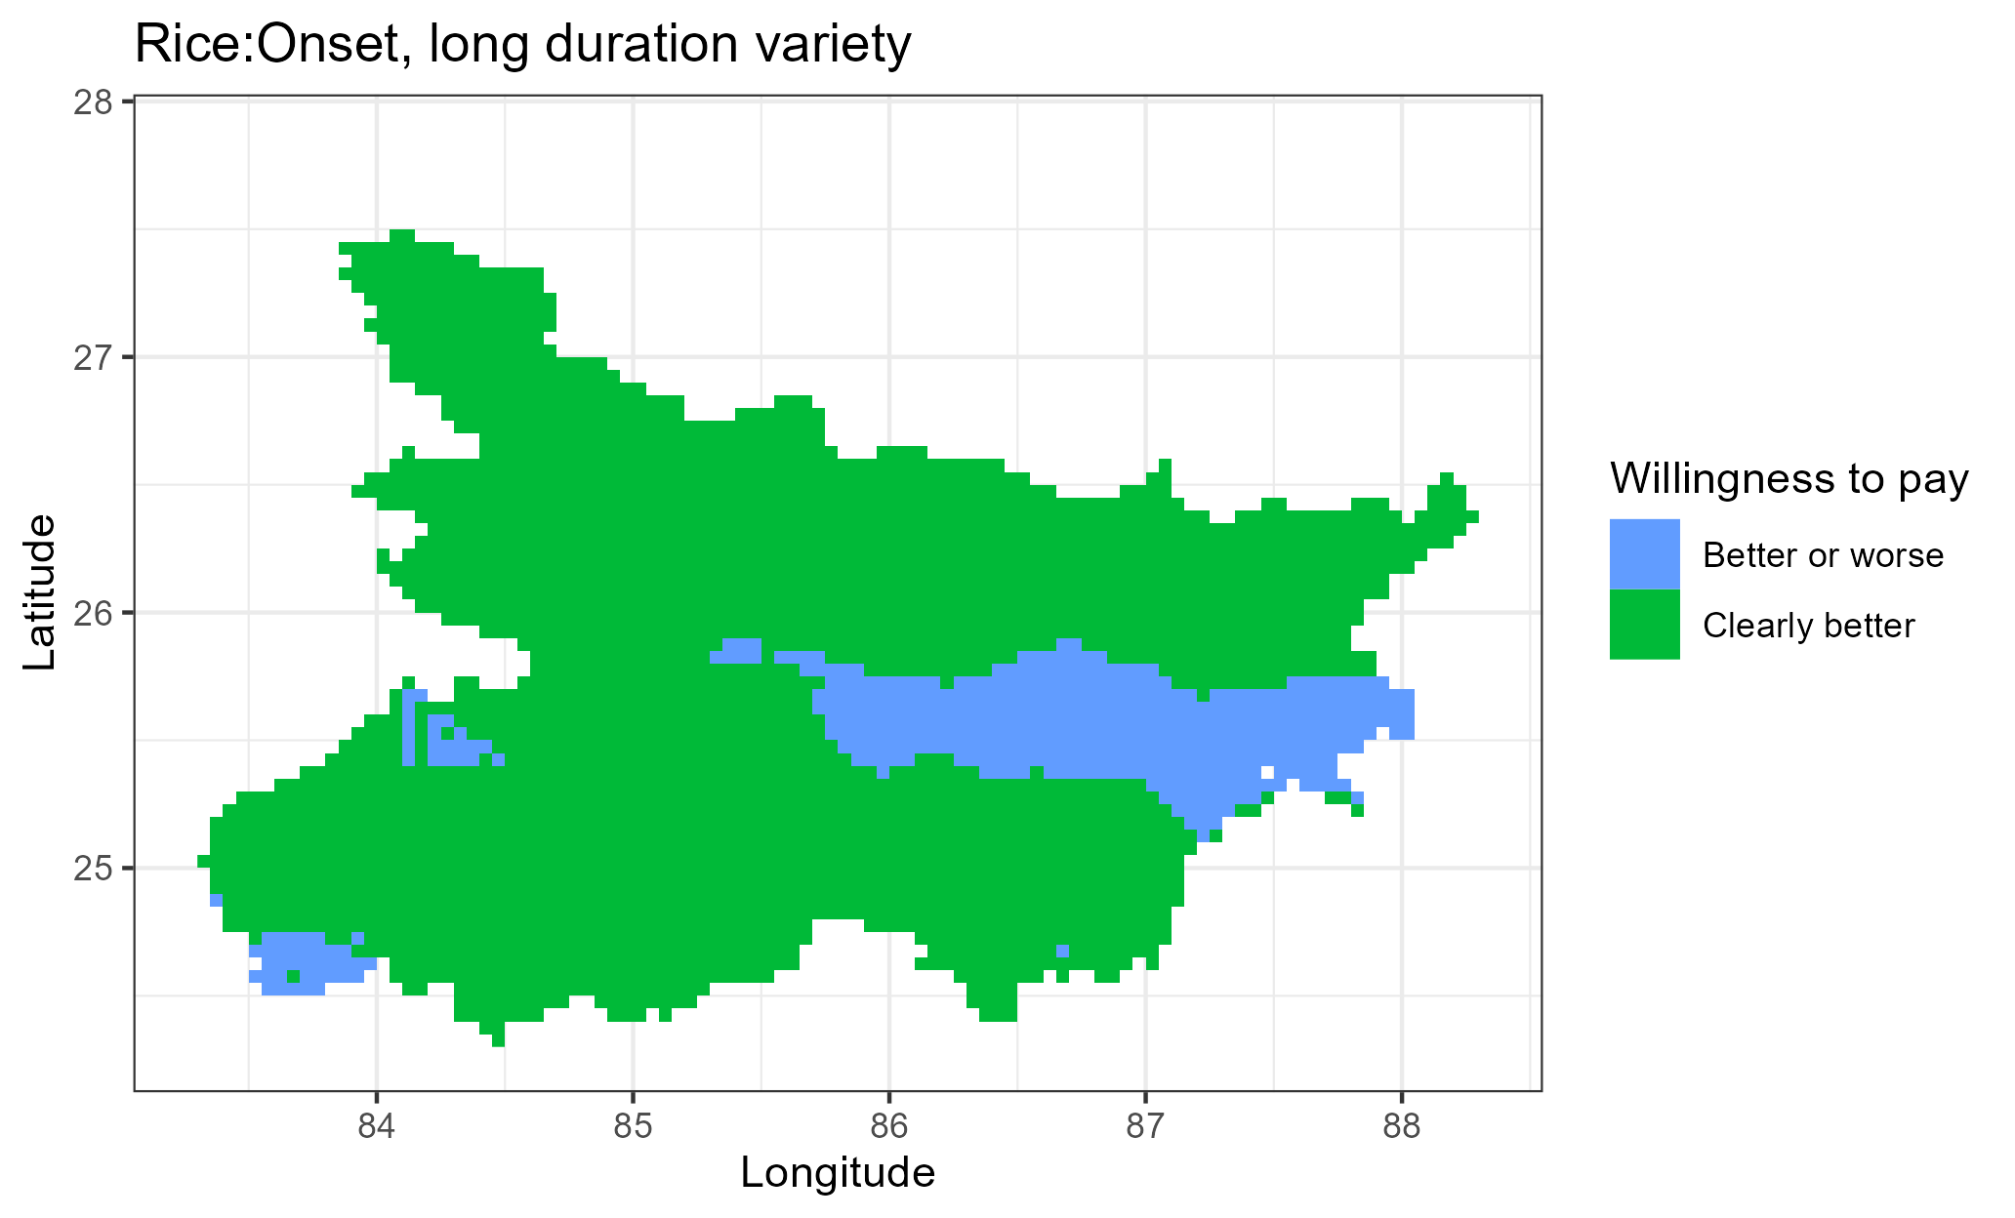
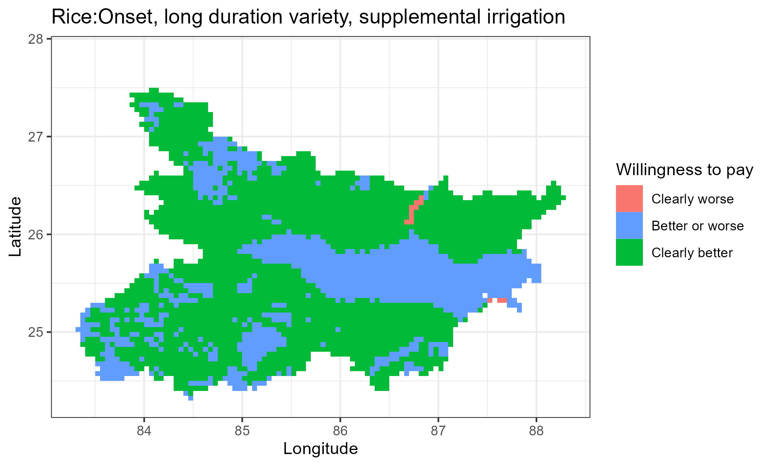
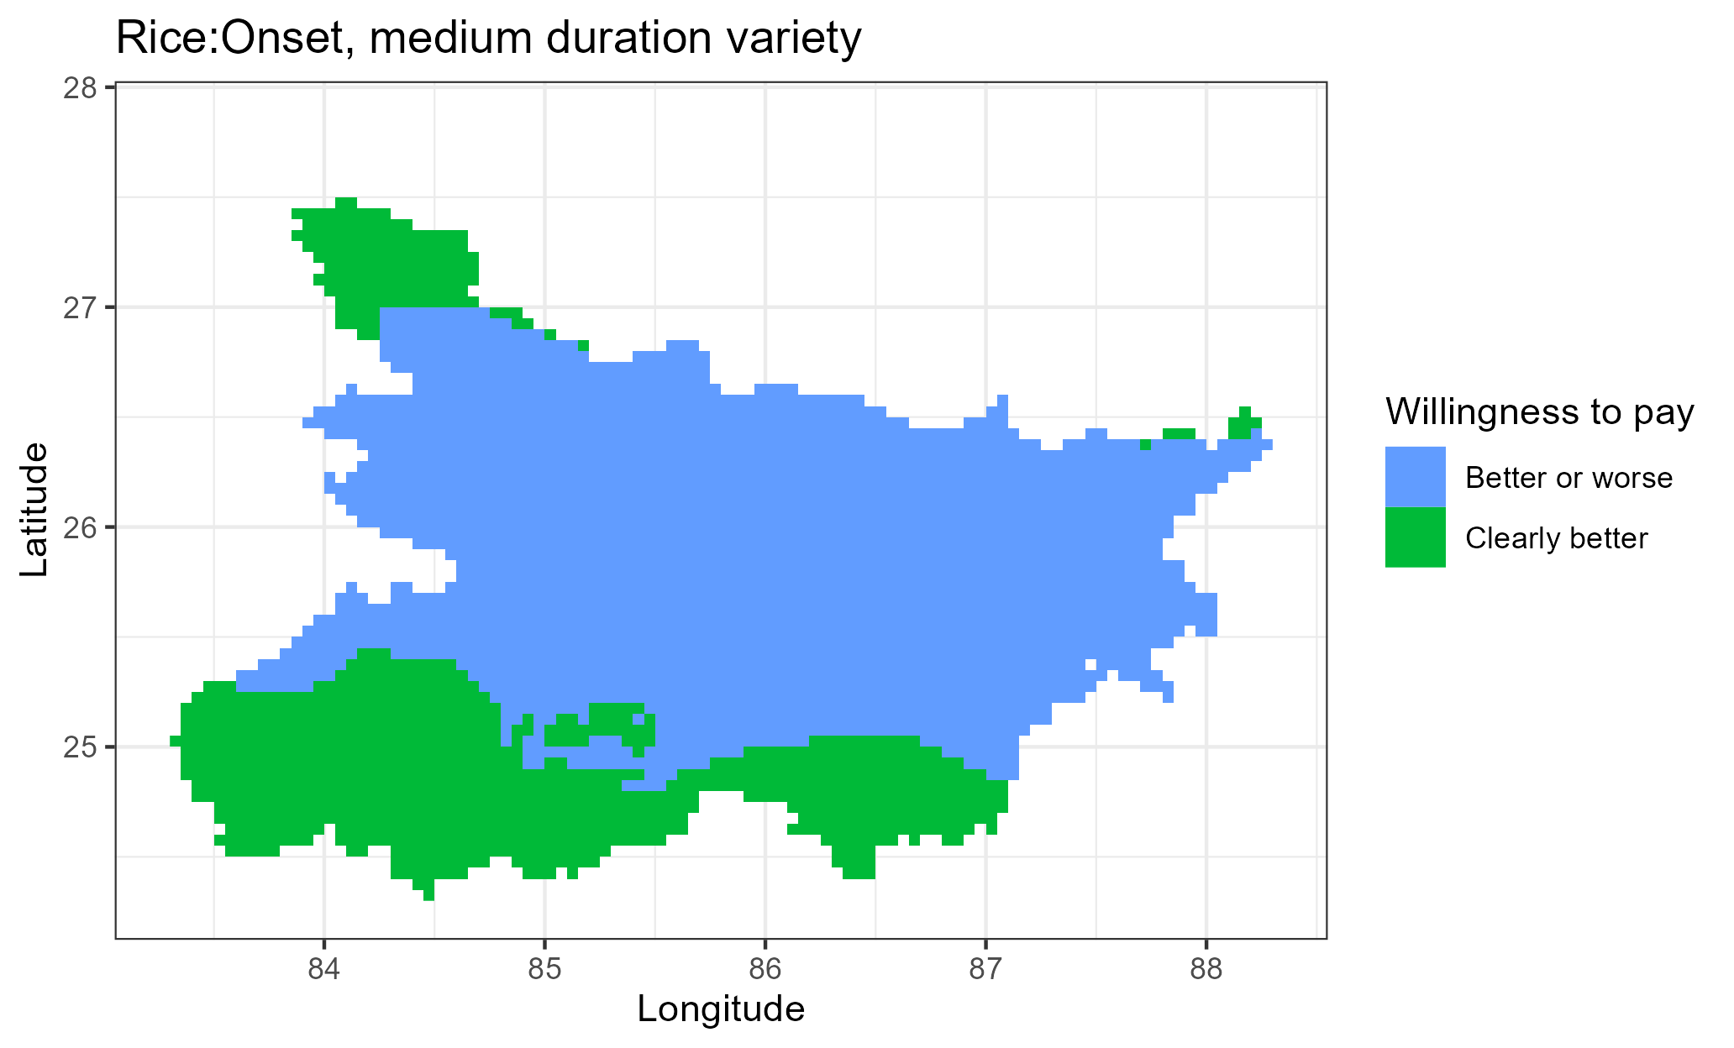

a
b
c
d
e
f

Slide 12
WHEAT

Slide 13
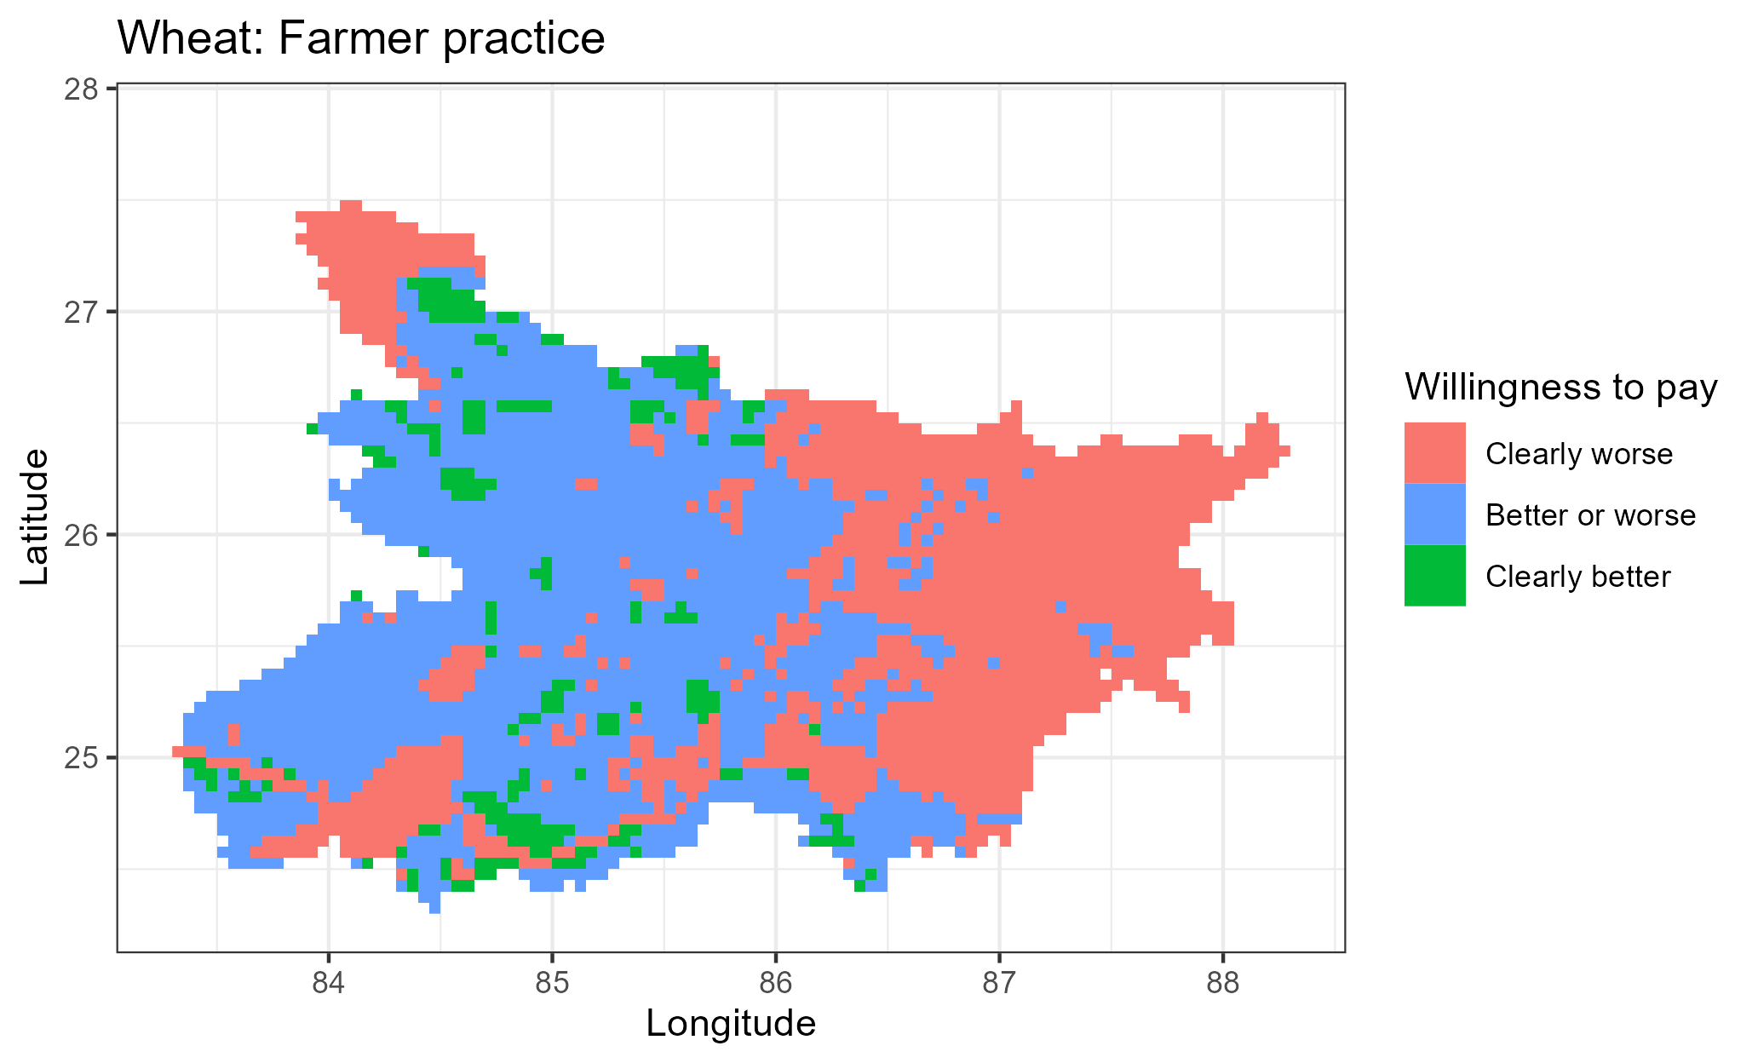
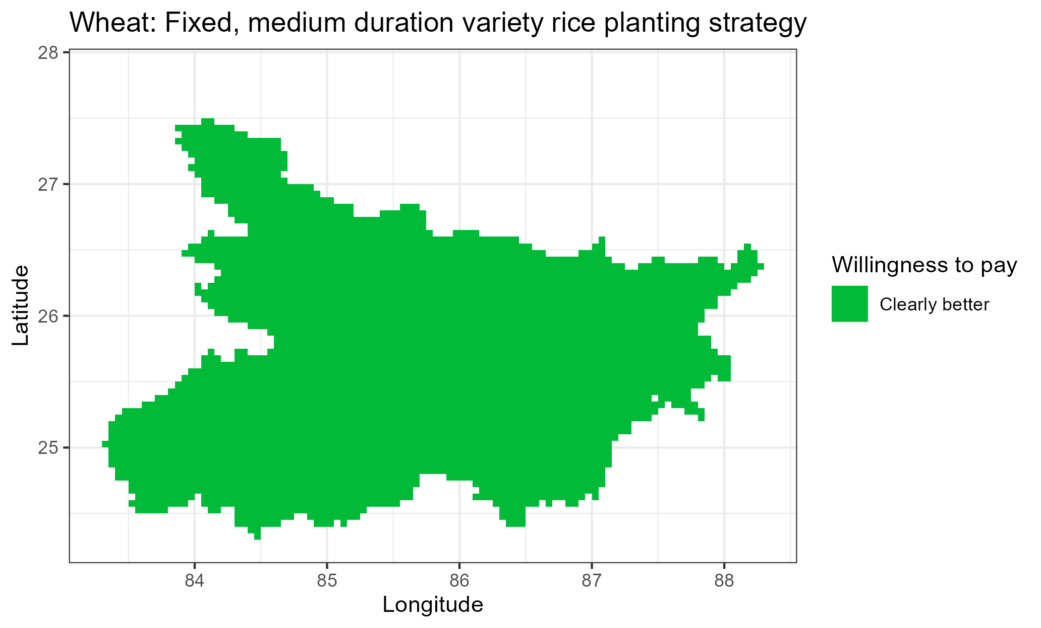

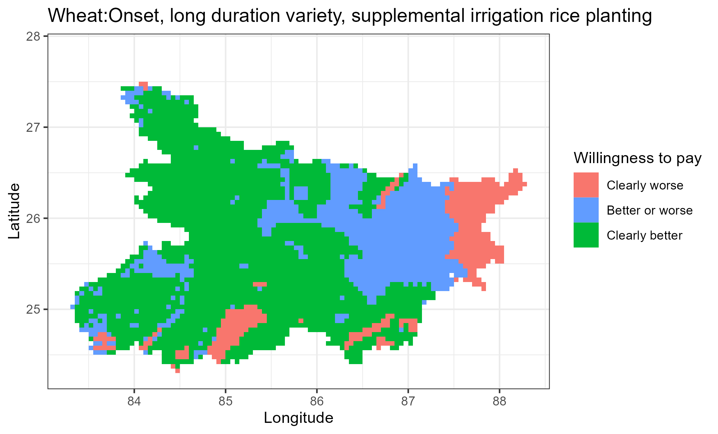
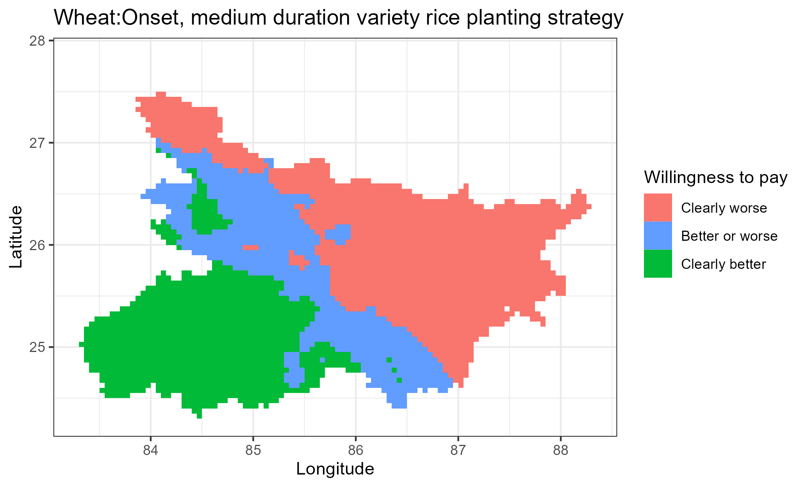
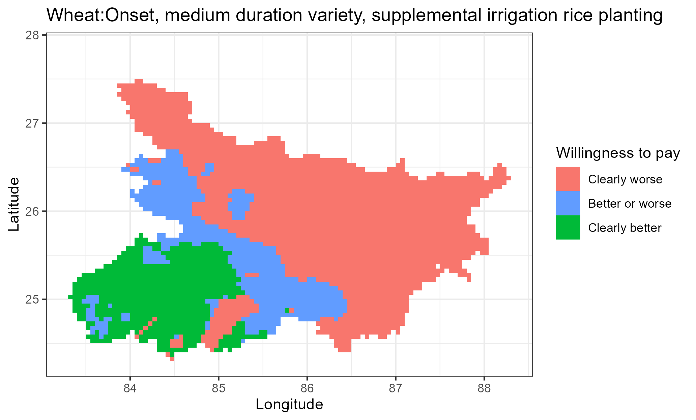
a
b
c
d
e
f

Slide 14
Economic assessment for each crop separately

Slide 15
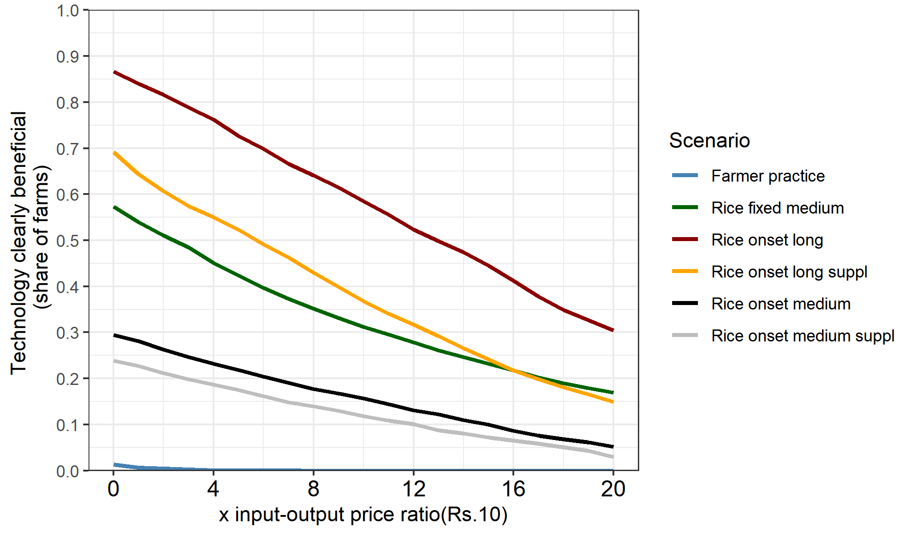
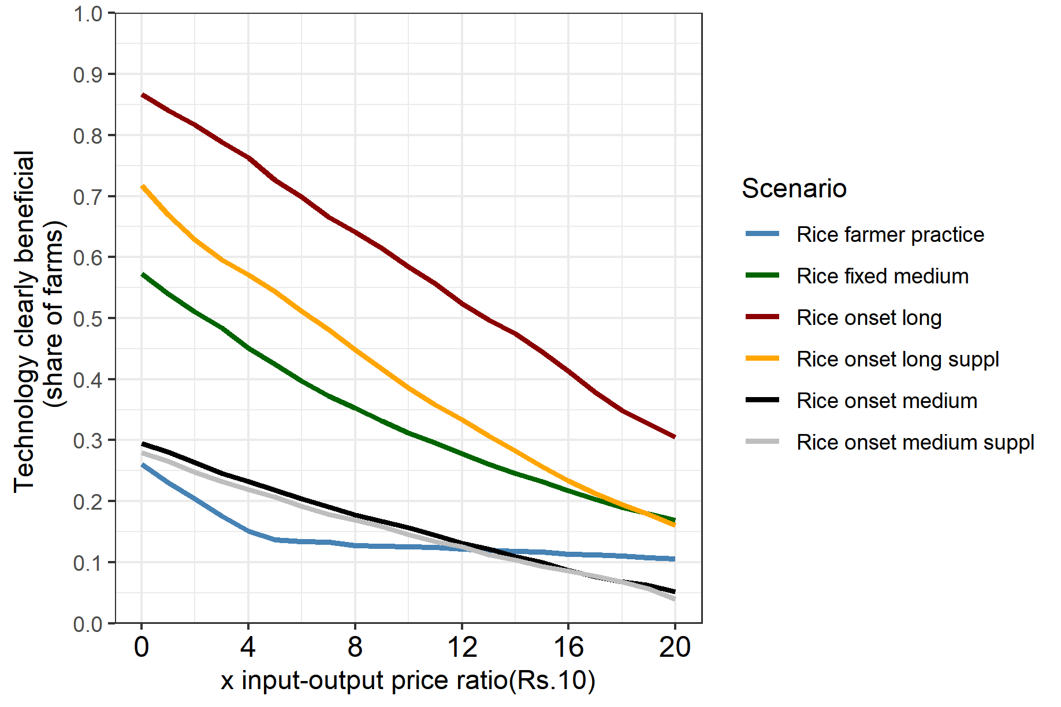
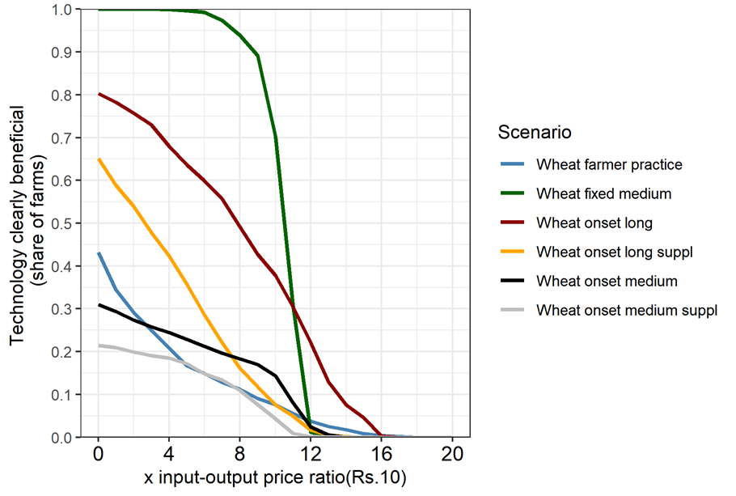
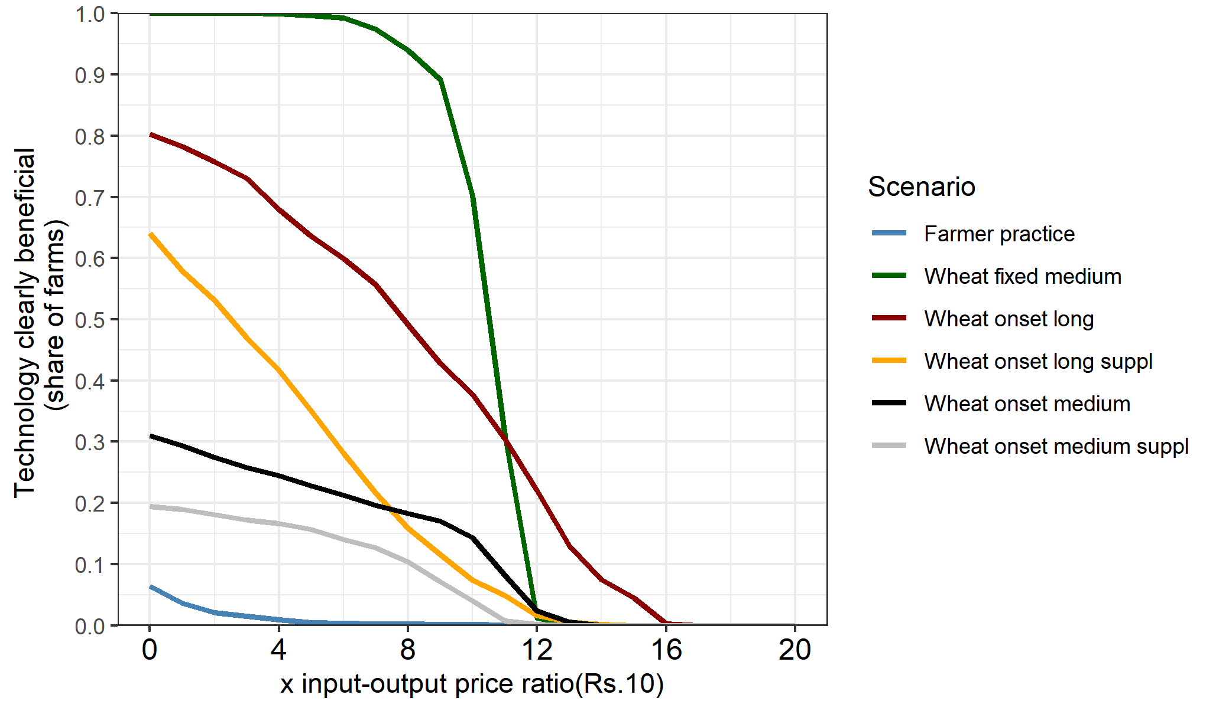
a. Without zero yield entries [fixed long as reference]
b. With zero yield entries [fixed long as reference]
Rice
Rice
Wheat
Wheat

Slide 16
Economic and risk assessment of cropping system

Slide 17
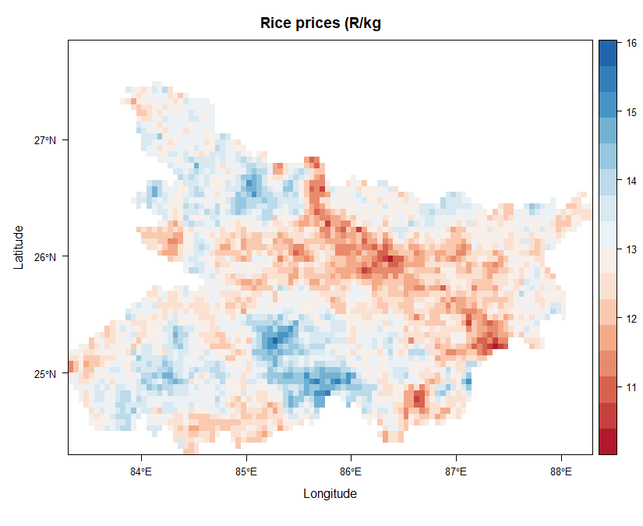
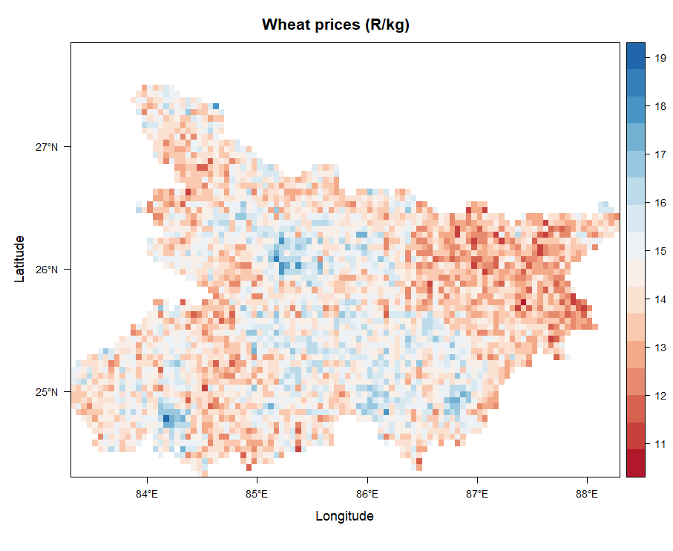
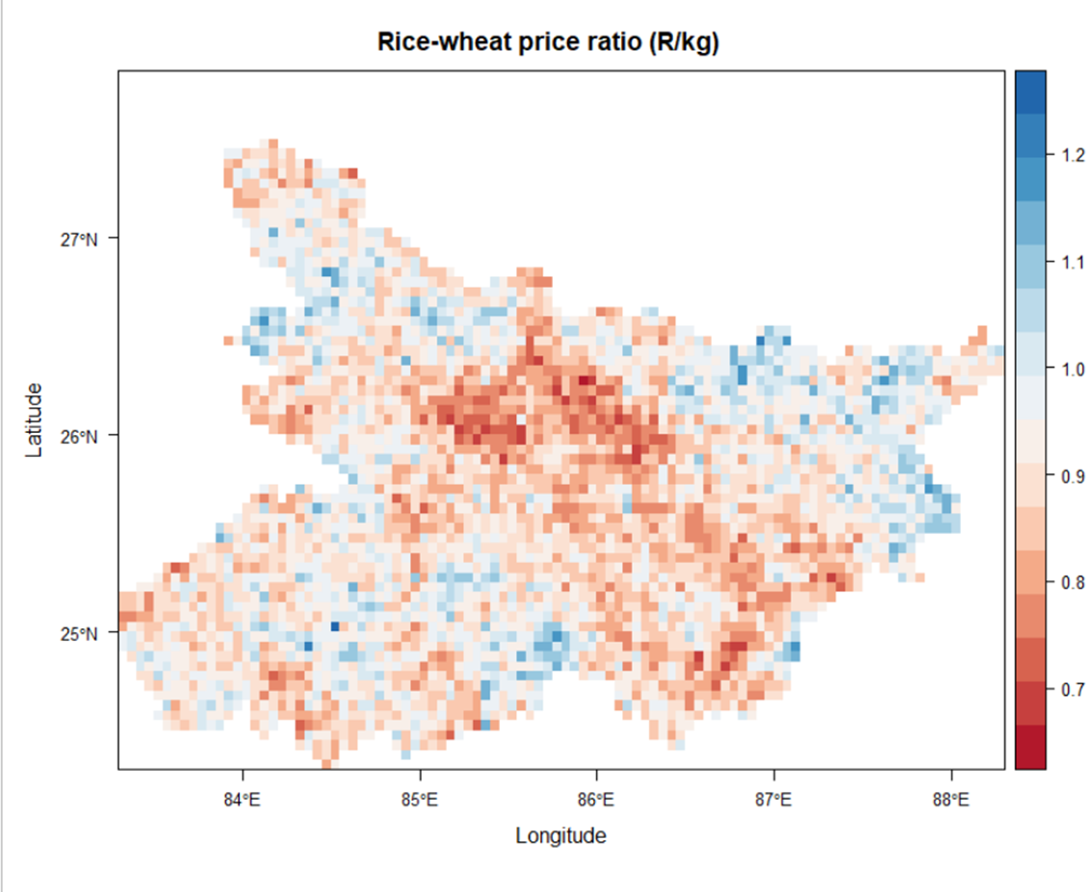
Interpolated rice and wheat prices

Slide 19

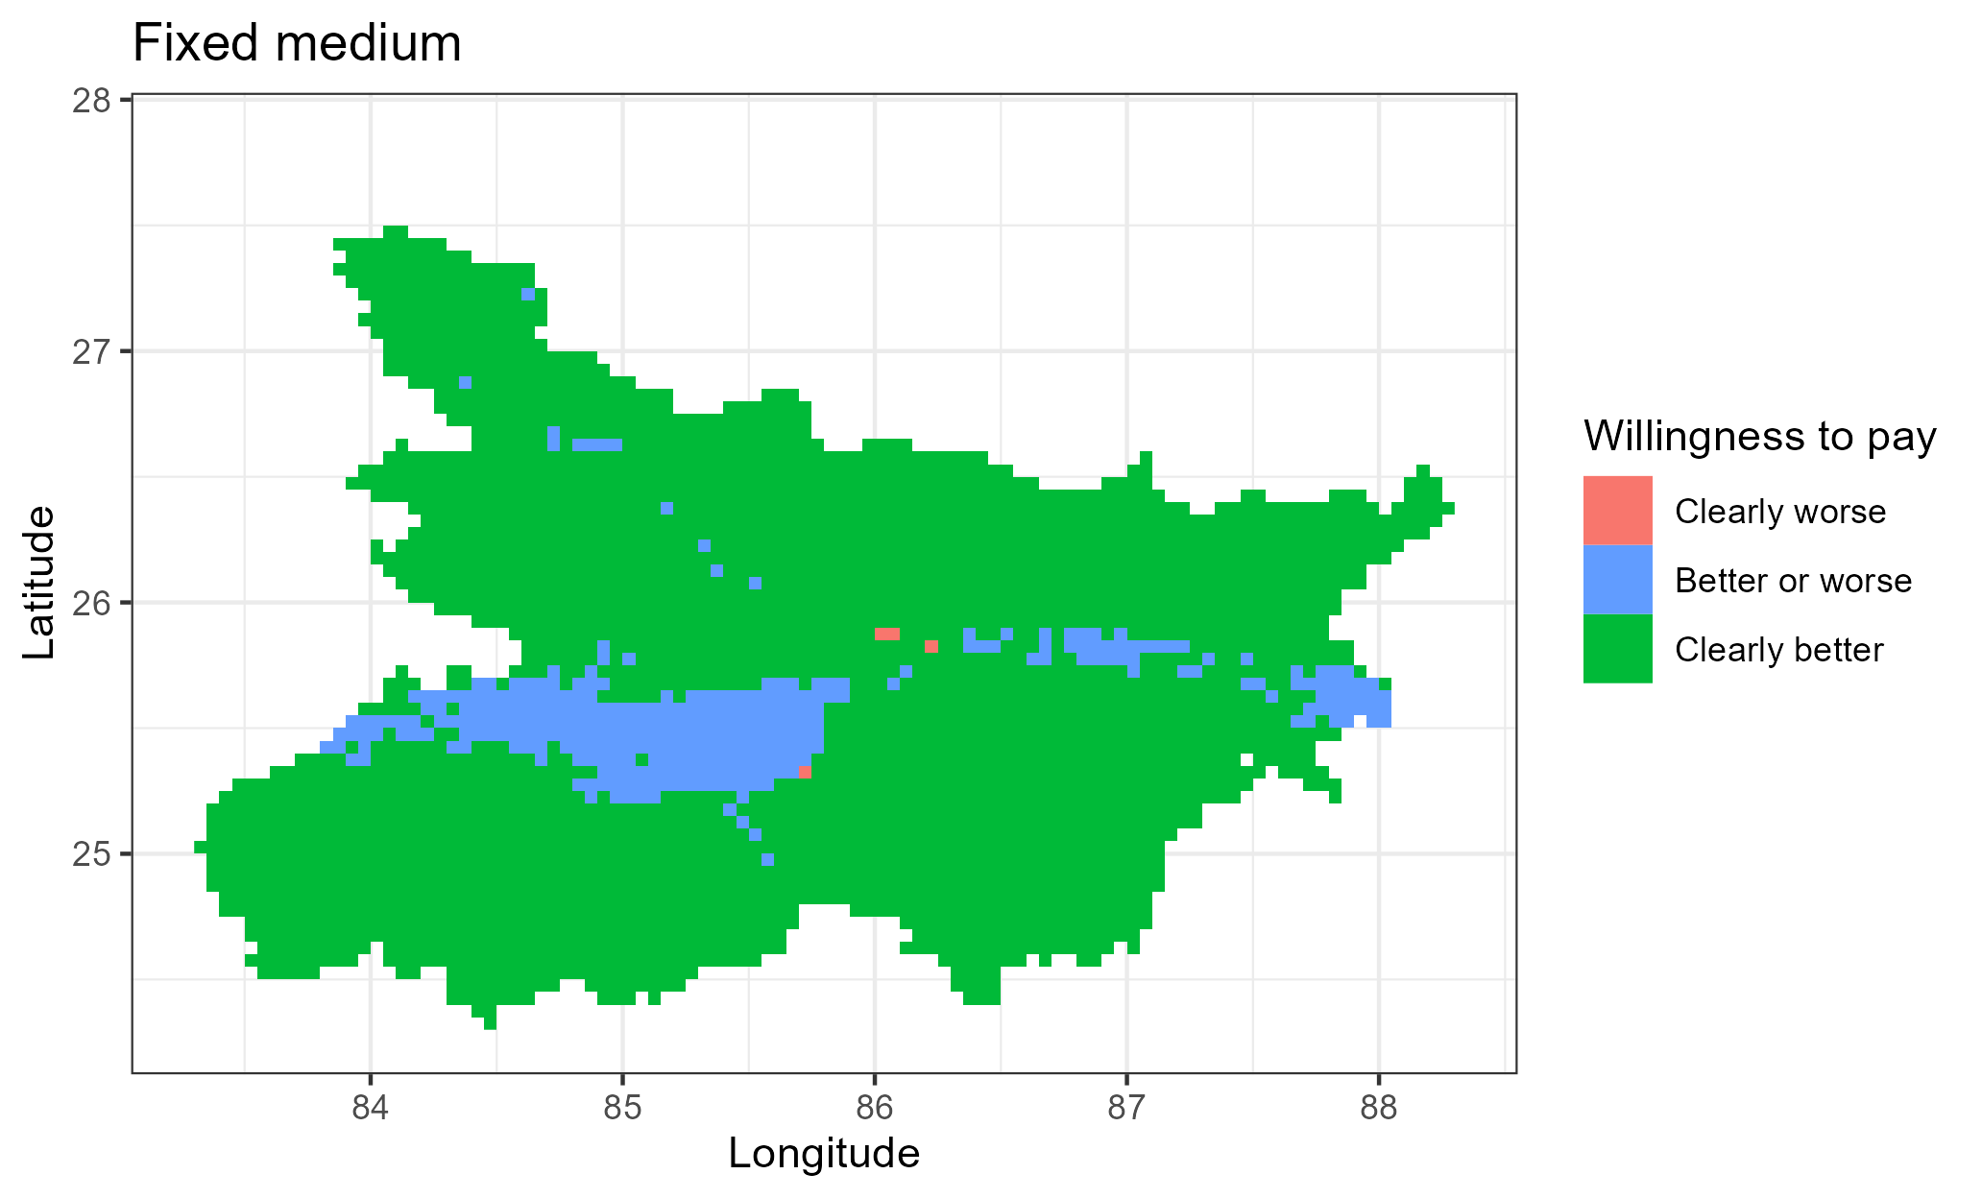
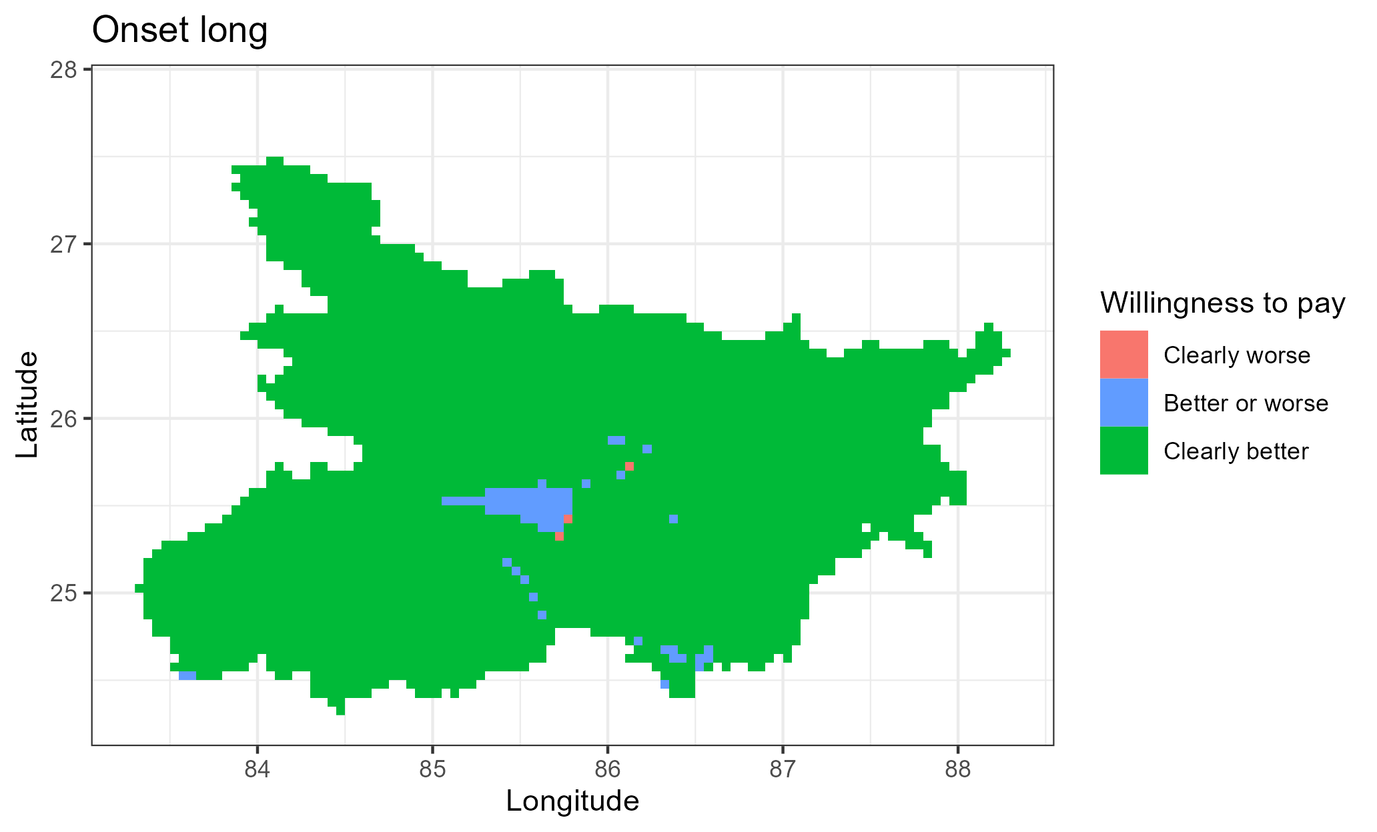
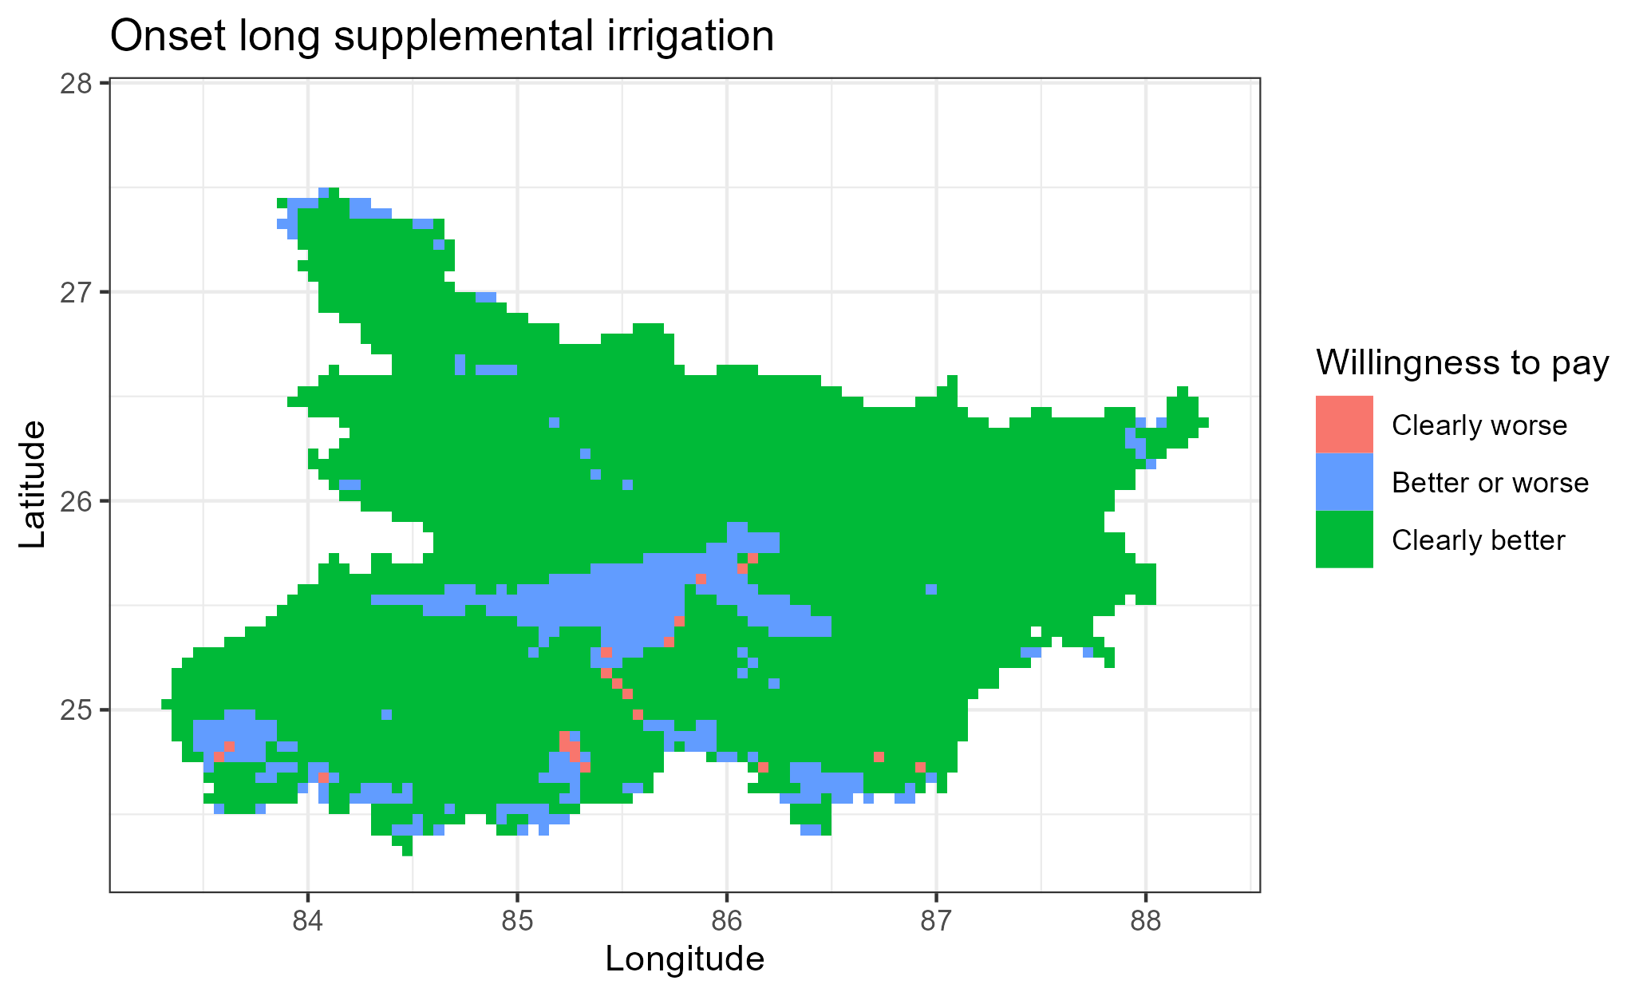
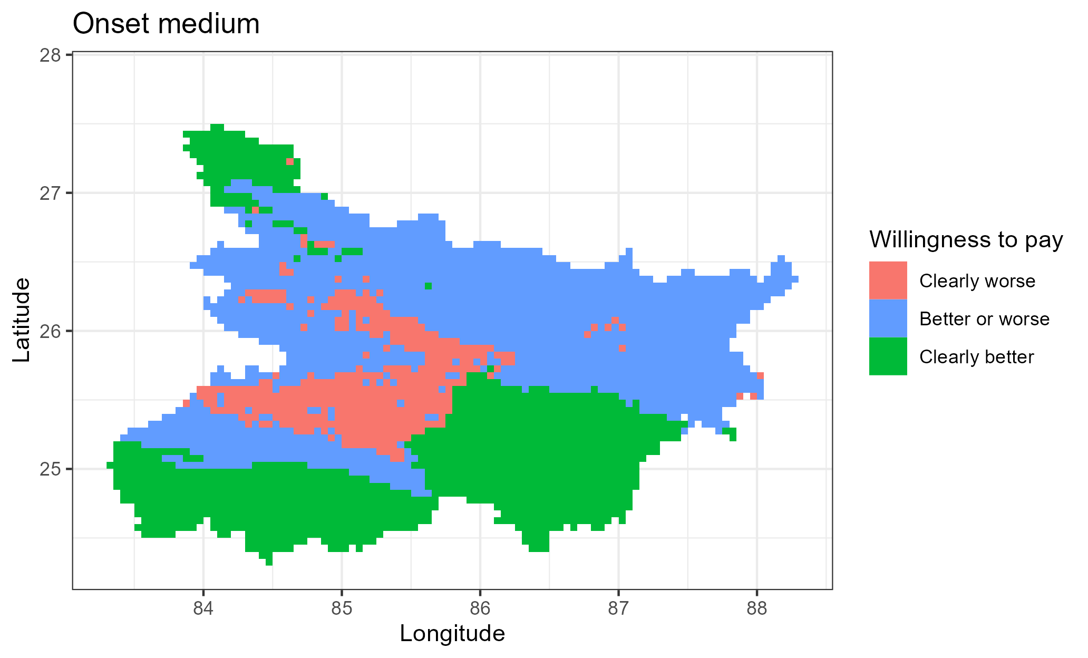
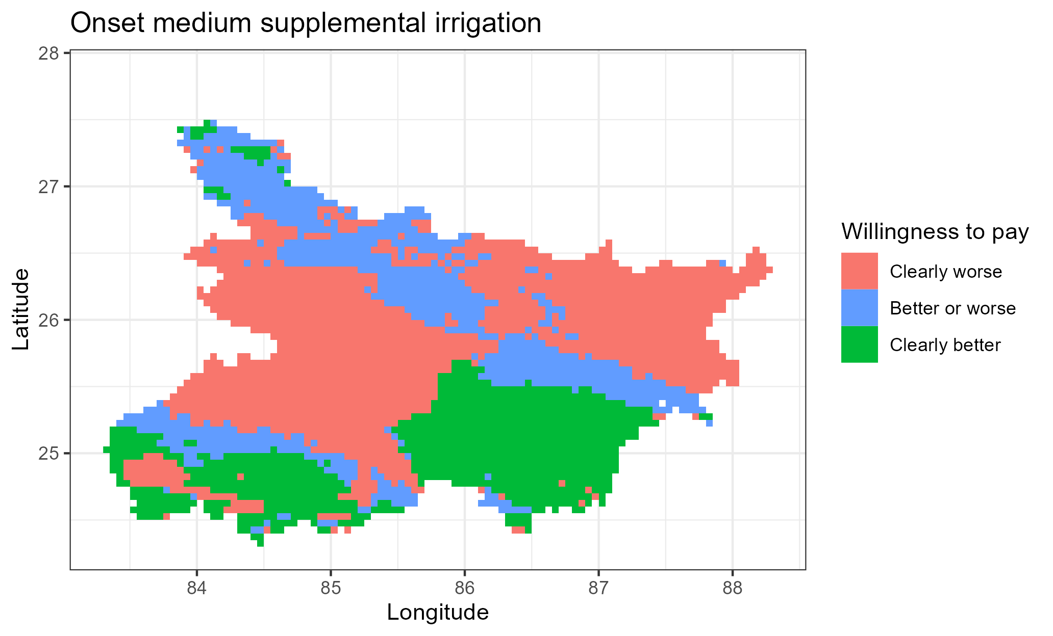

Slide 20
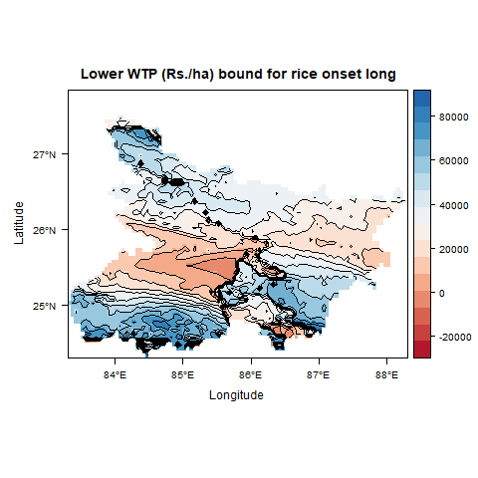
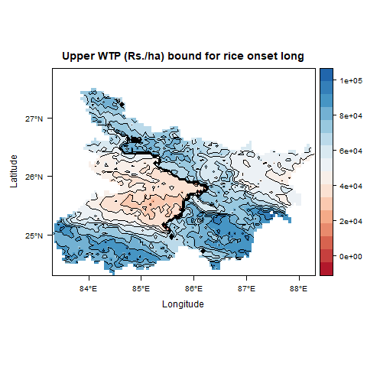

Understanding heterogeneity of WTP Bounds: Using onset-long duration as a case

Slide 21
Partial profit
Partial profit= Revenue-Irrigation Cost

Slide 22
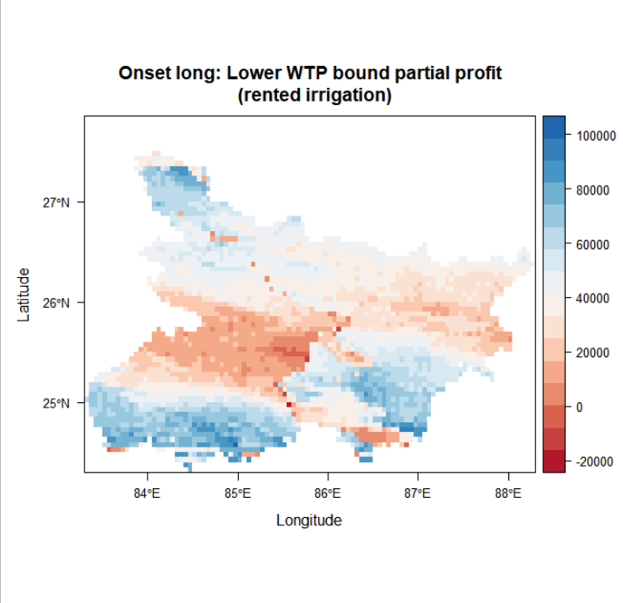
Indirect approach: Subtract Irrigation Cost from WTP Bounds and re-evaluate

Slide 23
Direct approach: Compute WTP Bounds for partial profit comparisons

Slide 24
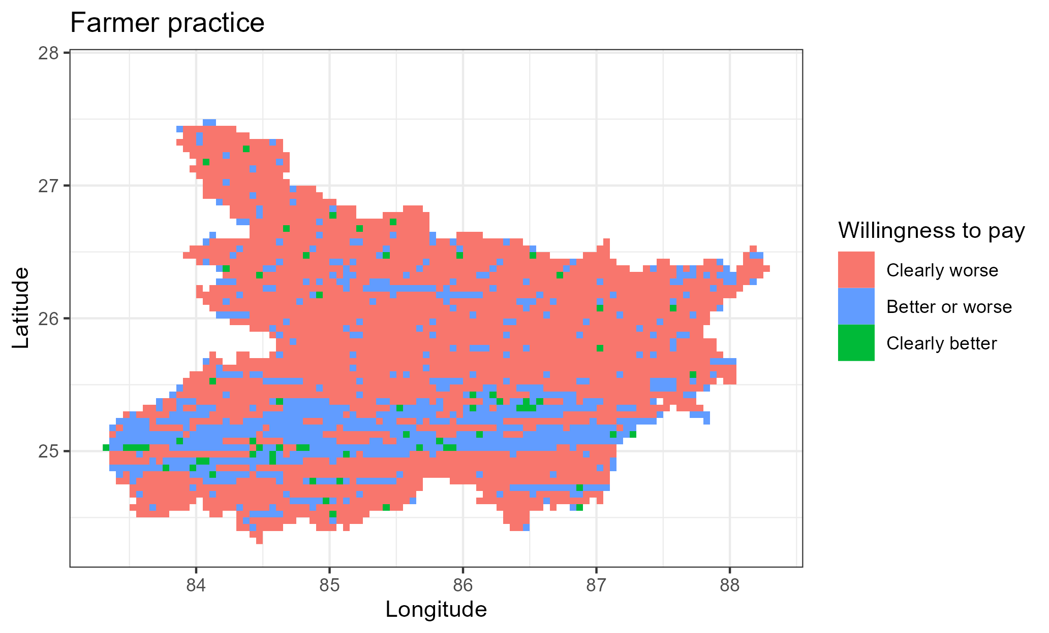



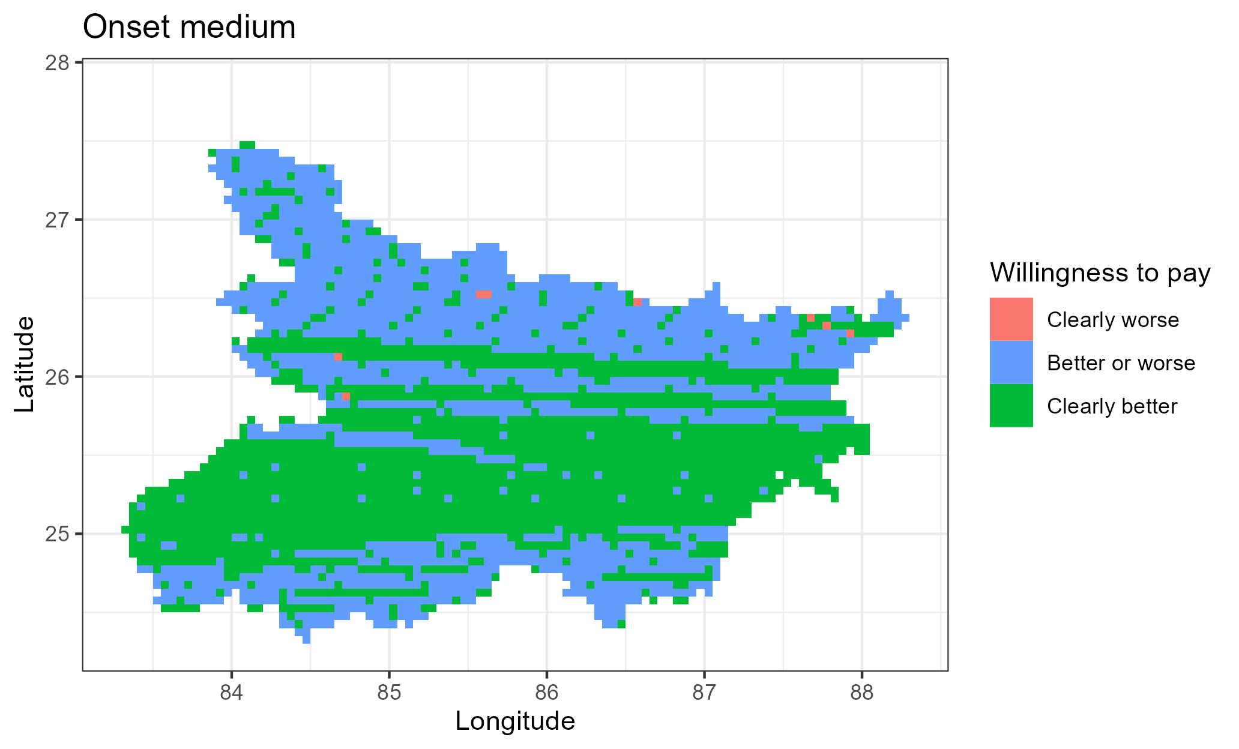
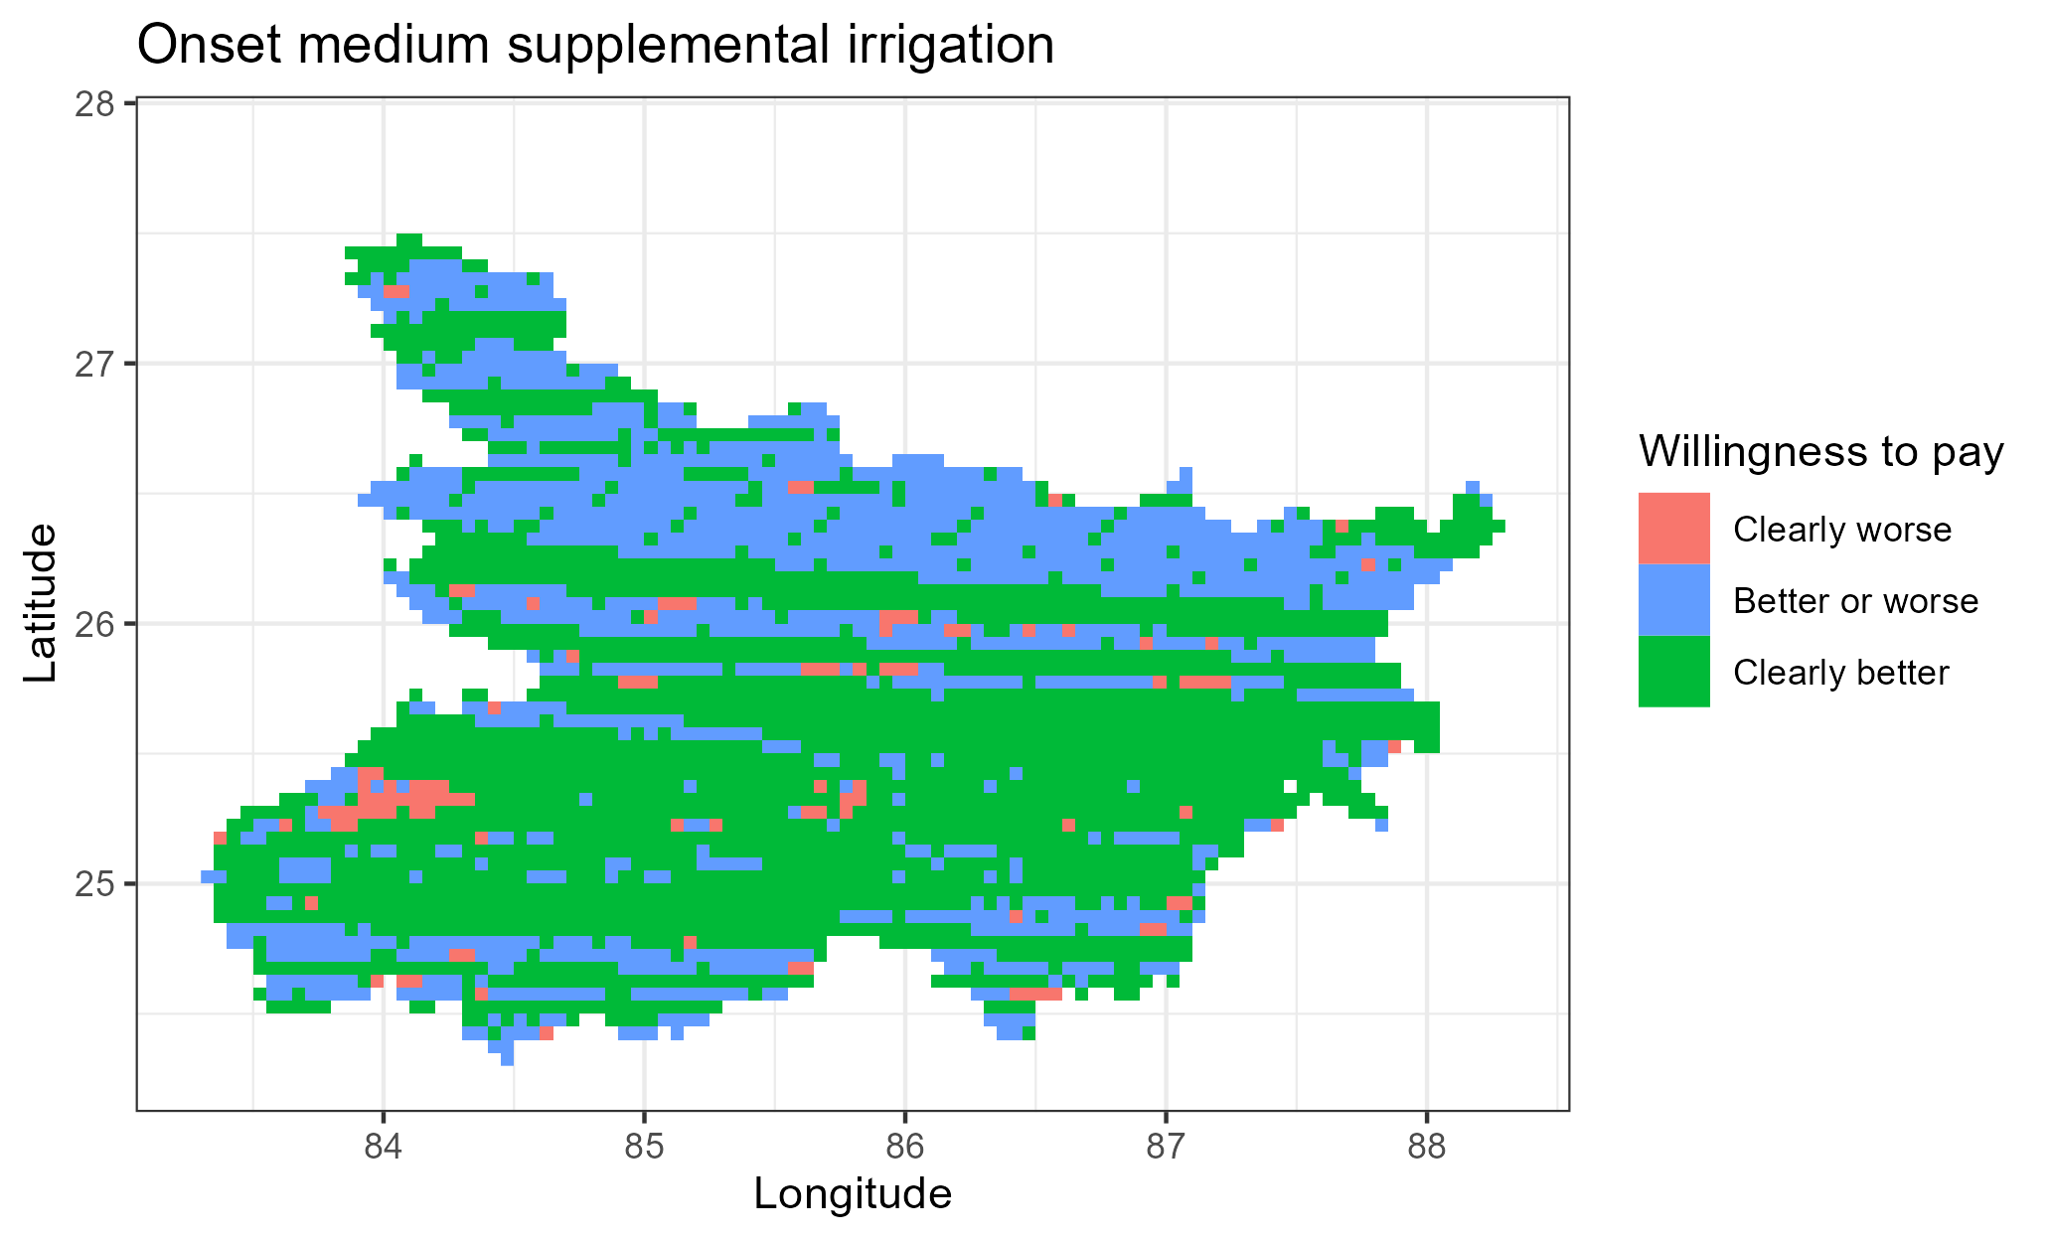

Slide 25
Conclusion
Planting date adjustments are proposed based on average yield benefits and stability (through standard deviation or absolute deviation from the mean) of the yield benefits.
This may be a suboptimal decision framework
It does not optimize on the mean-variability tradeoff
It neglects input and output prices in multi-input, multi-output cropping systems
It considers a limited number of moments (mean and variance) yet higher moments may be important
We have used second order stochastic dominance and using computational tools (in Octave) computed the willingness to pay bounds for a risk averse farmer to find the suggested rice planting strategy profitable.

Slide 26
Key references
Mean-variance portfolio theory approach
Nalley, L.L., and Barkley, A.P. 2010. “Using Portfolio Theory to Enhance Wheat Yield Stability in Low-Income Nations: An Application in the Yaqui Valley of Northwestern Mexico.” Journal of Agricultural and Resource Economics 35(2): 334-347. Url: https://www.jstor.org/stable/41960521.
Second order stochastic dominance approach
Hurley, T., Koo, J., and Tesfaye, K. 2018. “Weather risk: how does it change the yield benefits of nitrogen fertilizer and improved maize varieties in sub-Saharan Africa?” Agricultural Economics 49: 711-723. Doi: 10.1111/agec.12454.
Crop simulation results and stability analyses
Montes, C., Urfels, A., Han, E., and Balwinder-Singh. 2022. “Planting rice at monsoon onset could mitigate the impact of temperature stress on rice-wheat systems of Bihar, India.” Atmosphere 14(1), 40. Doi: https://doi.org/10.3390/atmos14010040.
Urfels, A., Montes, C., Balwinder-Singh, Halsema, G., Struik, P., Krupnik, T., and McDonald, J. 2022. “Climate adaptative rice planting strategies diverge across environmental gradients in the Indo-Gangetic Plains.” Environmental Research Letters 17: 124030. Doi: 10.1088/1748-9326/aca5a2.

Slide 27
Appendices

